Slide 2
City of South Lake Tahoe Clean-up Reorganization LAFCO Project No. 2024-01
Agenda Item #2
March 26, 2025

Slide 3
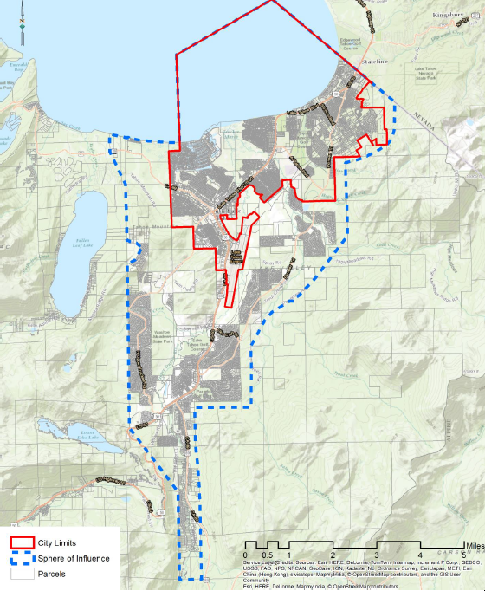
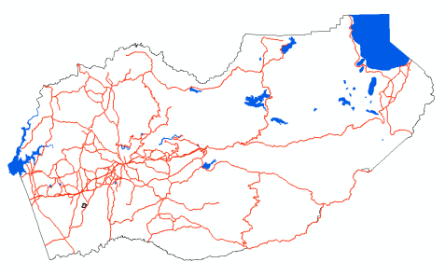
City of South Lake Tahoe Clean-up Reorganization
LAFCO Project No. 2024-01
Proposal
Annex 79 acres (80 parcels) into the City of South Lake Tahoe
Concurrent detachment from the Lake Valley Fire Protection District
Purpose
The proposal areas are adjacent to the City and within the City’s sphere of influence, but they are within unincorporated El Dorado County for services, despite being part of City neighborhoods and accessible only through City streets.
The City is requesting annexation of certain areas where it makes sense for the City to be the primary provider of governmental services such as planning and land use, law enforcement, snow removal, street maintenance, drainage, and fire protection and emergency medical services.
Agenda Item #6
Notes:
General annexation area is well within City’s SOI

Slide 4
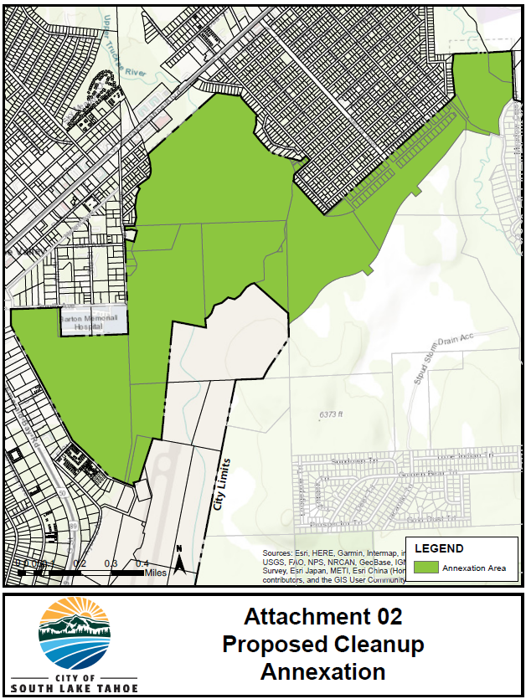
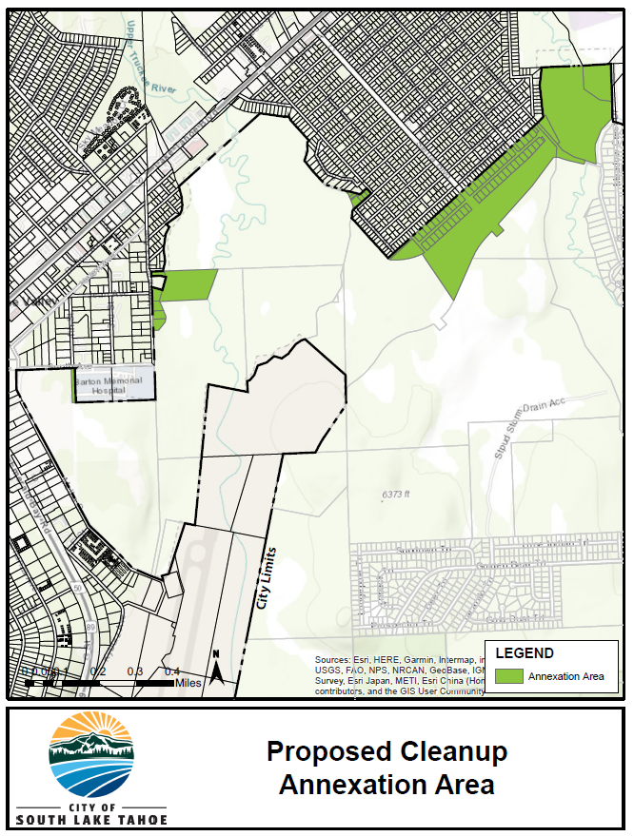
City of South Lake Tahoe Clean-up Reorganization
LAFCO Project No. 2024-01
Original Proposal – March 26, 2024:
Revised Proposal – October 9, 2024:
Notes:
March 2024 – the City adopted a resolution of application for “City of South Lake Tahoe Clean-up Annexation”, to annex 411 acres into the City with concurrent detachment from Lake Valley FPD.
However, after discussions with some of the affected landowners, in October 2024 the City revised the scope of the proposal removing 327 acres from the annexation area, including the Tahoe Valley Campground and Johnson Meadow area.
As revised, the current proposal is to annex 79 acres, 80 parcels, with concurrent detachment from the Lake Valley FPD.

Slide 5
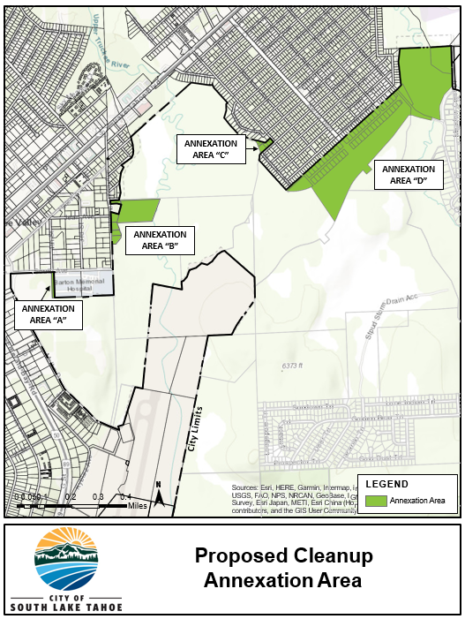
City of South Lake Tahoe Clean-up Reorganization
LAFCO Project No. 2024-01
Area | General Location | Parcels | Acres | Description
A | 4th Street, west of Barton Hospital | 1 | 0.57 | Public right-of-way; nontaxable
B | Winnemucca Ave | 6 | 9.04 | Privately owned Mostly vacant, one developed parcel with single-family residence
C | Alma Ave & Lodi Ave, adjacent to Tahoe Sierra neighborhood | 10 | 1.06 | Private and public ownership Four developed parcels with single-family residences; smaller lots unbuildable
D | Barbara Ave, adjacent to Tahoe Sierra neighborhood | 63 | 68.61 | All publicly owned: State of California Lake Tahoe Community College District US Forest Service City of South Lake Tahoe South Tahoe Public Utility District All vacant or public right-of-way; all nontaxable
Notes:
The proposed reorganization consists of four separate areas (A-D).
The majority of the parcels are publicly owned and vacant (67), compared to privately owned parcels (13).
Out of the 80 parcels, only 5 are developed, and all of them are privately owned.

Slide 6
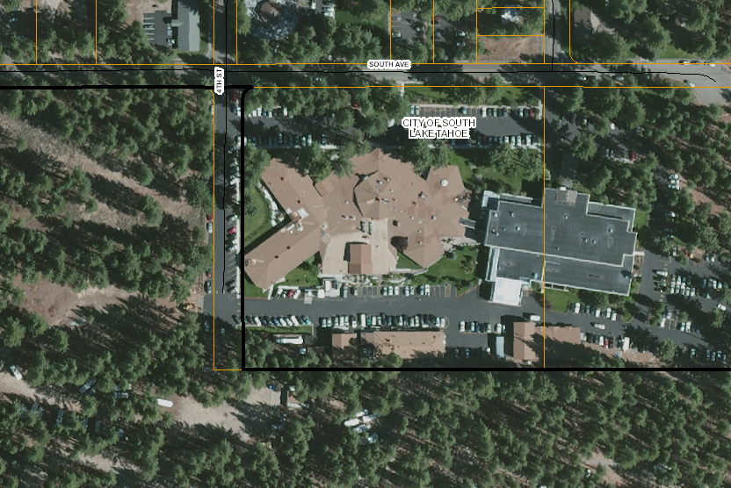
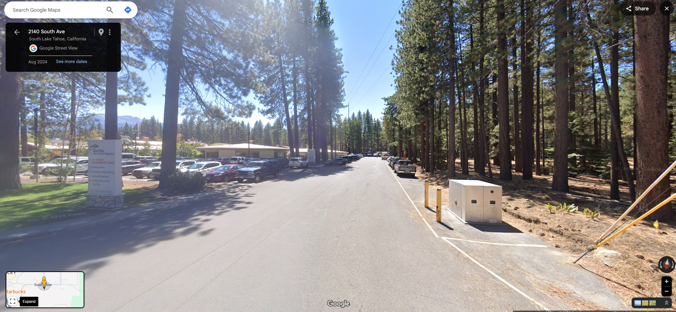
City of South Lake Tahoe Clean-up Reorganization
LAFCO Project No. 2024-01
Annexation Area A:
Area | General Location | Parcels | Acres | Description
A | 4th Street, west of Barton Hospital | 1 | 0.57 | Public right-of-way; nontaxable
4th Street

Slide 7
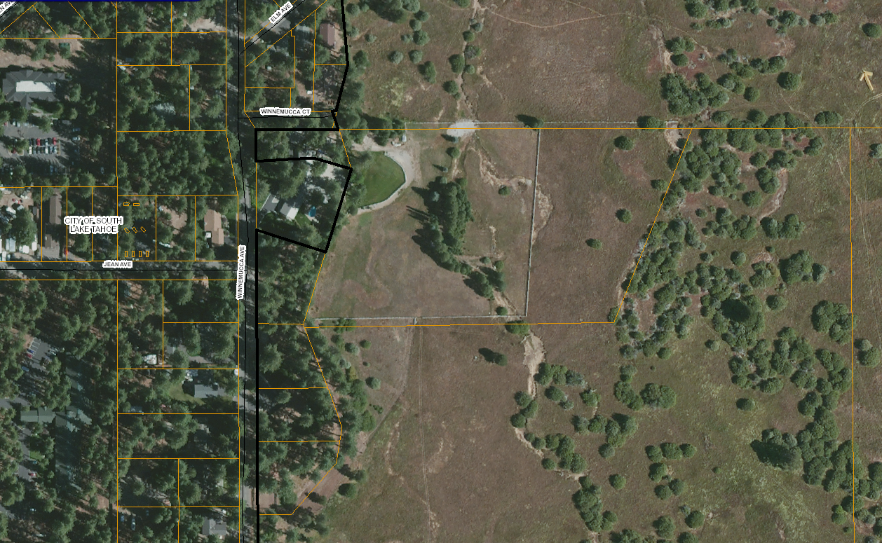
City of South Lake Tahoe Clean-up Reorganization
LAFCO Project No. 2024-01
Annexation Area B:
Area | General Location | Parcels | Acres | Description
B | Winnemucca Ave | 6 | 9.04 | Privately owned Mostly vacant, one developed parcel with single-family residence
Winnemucca Ave

Slide 8
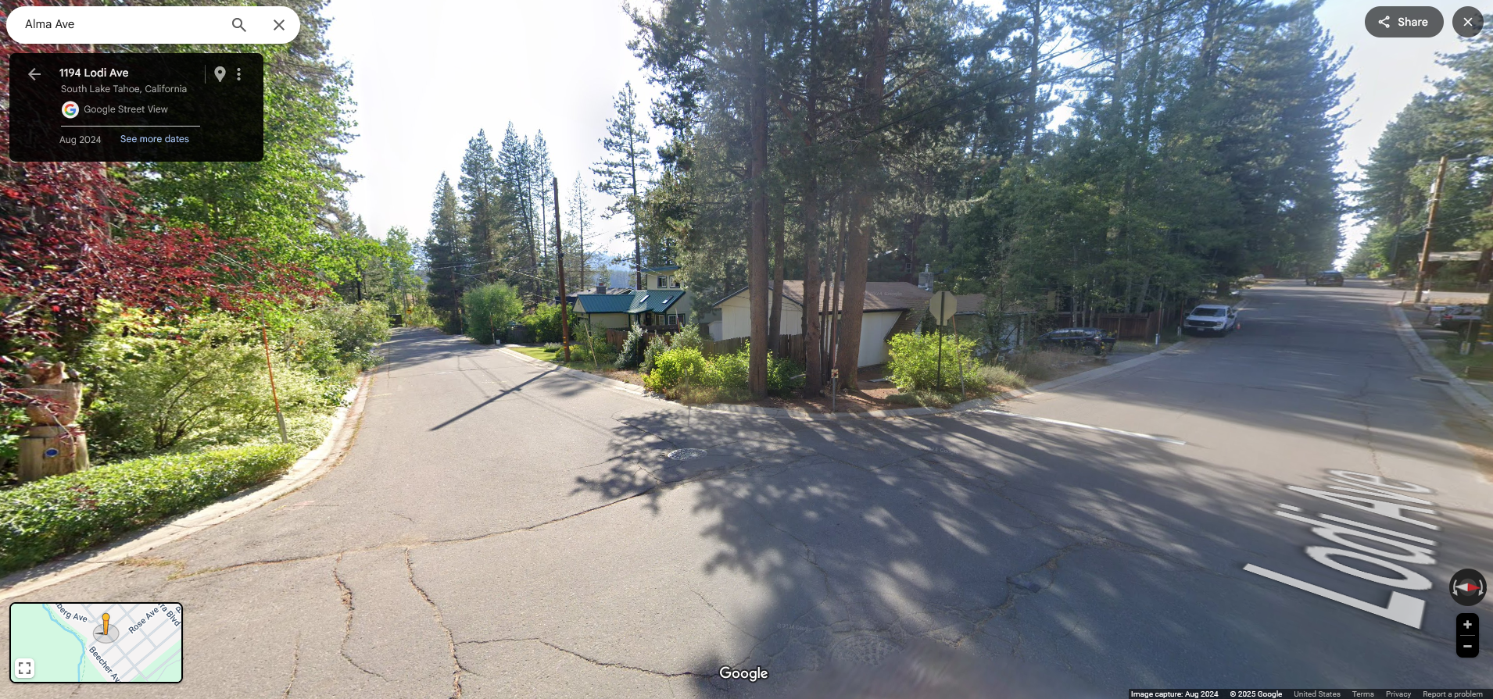
City of South Lake Tahoe Clean-up Reorganization
LAFCO Project No. 2024-01
Annexation Area C:
Area | General Location | Parcels | Acres | Description
C | Alma Ave & Lodi Ave, adjacent to Tahoe Sierra neighborhood | 10 | 1.06 | Private and public ownership Four developed parcels with single-family residences; smaller lots unbuildable
Alma Ave & Lodi Ave

Slide 9
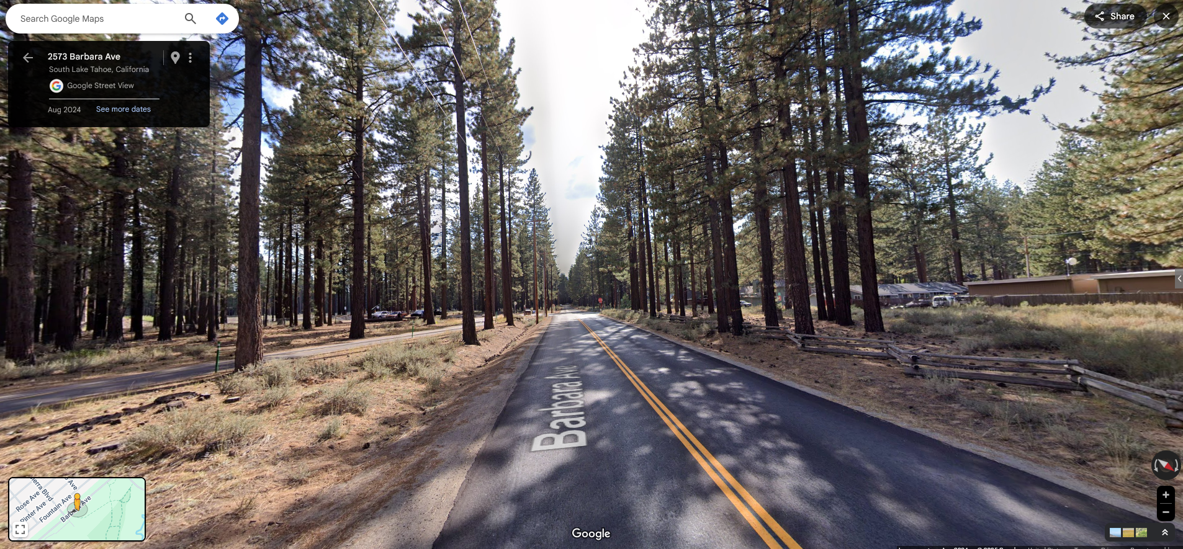
City of South Lake Tahoe Clean-up Reorganization
LAFCO Project No. 2024-01
Annexation Area D:
Area | General Location | Parcels | Acres | Description
D | Barbara Ave, adjacent to Tahoe Sierra neighborhood | 63 | 68.61 | All publicly owned: State of California Lake Tahoe Community College District US Forest Service City of South Lake Tahoe South Tahoe Public Utility District All vacant or public right-of-way; all nontaxable
Barbara Ave

Slide 10
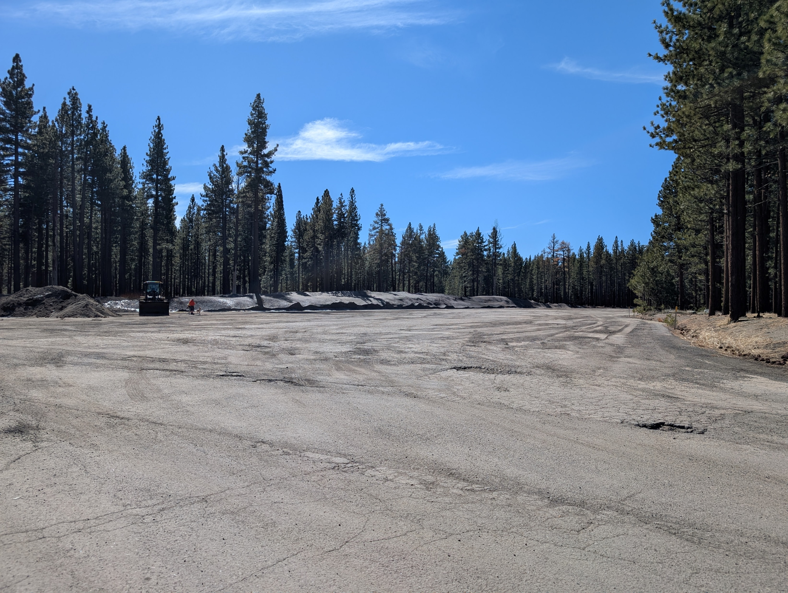
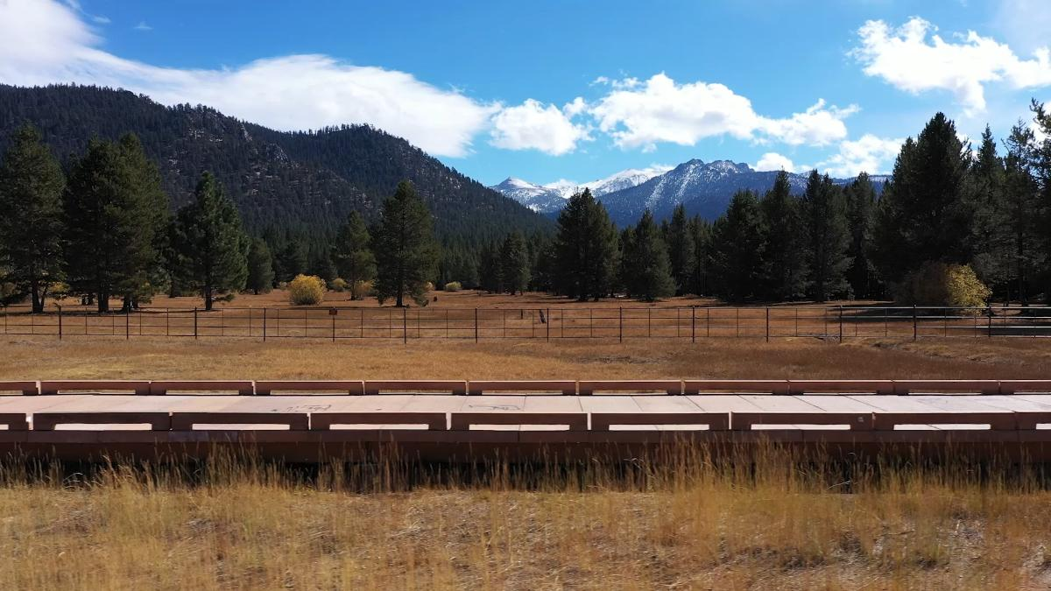
City of South Lake Tahoe Clean-up Reorganization
LAFCO Project No. 2024-01
Annexation Area D continued:
Public Right-of-Way
Dennis T. Machida Greenway

Slide 11
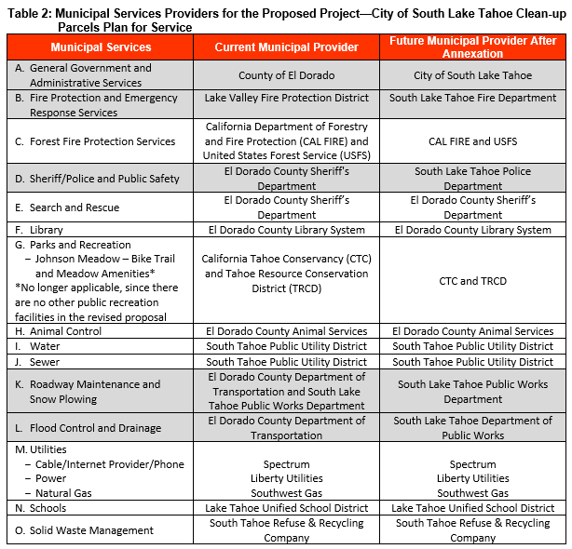
City of South Lake Tahoe Clean-up Reorganization
LAFCO Project No. 2024-01
Agenda Item #6

Slide 12
City of South Lake Tahoe Clean-up Reorganization
LAFCO Project No. 2024-01
COST AND REVENUES
Cost to Provide Service – City estimated annual cost of $5,413
Expected Revenue – El Dorado County and the City of South Lake Tahoe agreed to the following property tax redistribution, pending successful reorganization:
$12,200 transfer in base property tax revenue to the City starting in fiscal year 2025-26
Future property tax increment of 21.9744% to 24.3355% to be allocated to the City for the annexed areas, based on the tax rate area
0.0% increment to the Lake Valley Fire Protection District as a result of detachment
Sufficiency of Revenue – Negotiated property tax base transfer and future property tax increments are expected to be sufficient to cover the City’s cost to provide services
Agenda Item #6
Notes:
The publicly owned parcels have no assessed value. The total assessed value is largely derived from the private parcels in Areas B and C, with the exception of $3,500.

Slide 13
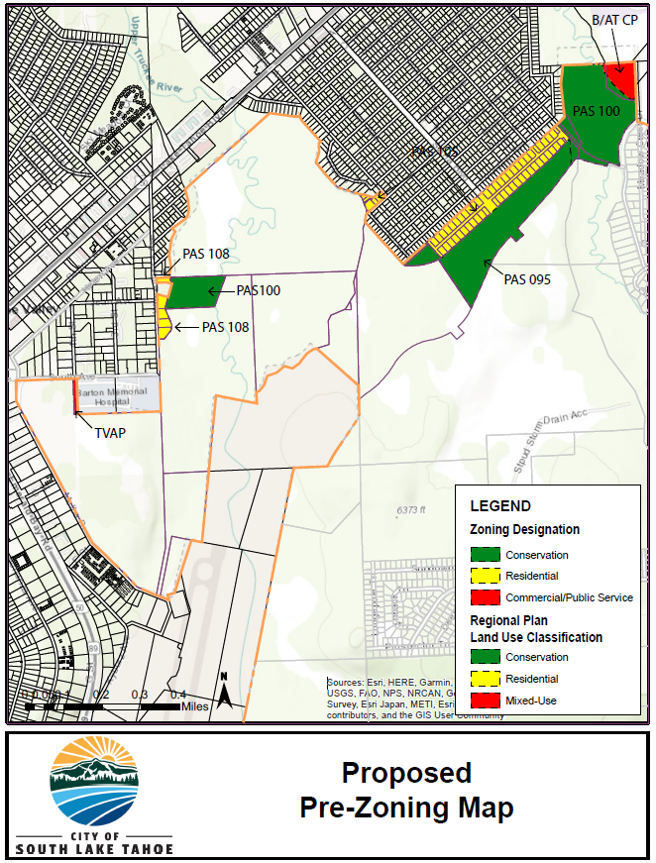
City of South Lake Tahoe Clean-up Reorganization
LAFCO Project No. 2024-01
Area | County Zoning | City Adopted Prezoning
 |  | TRPA Regional Plan Land Use | TRPA Zoning | TRPA Plan Area Statement
A | TC Transportation Corridor | Mixed-Use | Commercial / Public Service | Tahoe Valley Area Plan
B | RL-160 Rural Lands AG-160 Agricultural Grazing | Residential Conservation | Residential Conservation | PAS 108 Winnemucca PAS 100 Truckee Marsh
C | R1 Residential | Residential | Residential | PAS 105 Sierra Tract
D | R1 Residential RL-40 Rural Lands FR-160 Forest Resource | Residential Conservation Mixed-Use | Residential Conservation Commercial / Public Service | PAS 105 Sierria Tract PAS 095 Trout / Cold Creek PAS 100 Truckee Marsh Bijou / Al Tahoe Community Plan
Agenda Item #6

Slide 14
City of South Lake Tahoe Clean-up Reorganization
LAFCO Project No. 2024-01
California Environmental Quality Act (CEQA)
City of South Lake Tahoe is lead agency for this project for CEQA environmental review
Class 19 Categorical Exemption §15319(a) – annexations to a city of areas containing existing public or private structures developed to the density allowed by the current zoning or pre-zoning, whichever is more restrictive
Agenda Item #6

Slide 15
City of South Lake Tahoe Clean-up Reorganization
LAFCO Project No. 2024-01
Mailed Notices: | Affected Territory | 500ft Buffer
Landowners | 18 | 721
Registered Voters | 7 | 593
Conducting Authority (Protest) Hearing:
Potentially required because reorganization was initiated by City Council resolution
Provides an opportunity for landowners within the affected territory to protest the reorganization (uninhabited)
If required, staff recommends scheduling the protest hearing for May 28, 2025
Any landowner within the affected territory may submit a written protest; notices and protest forms will be mailed 21-days in advance of the hearing
Waiver of Protest Proceedings:
The Commission may waive the protest proceedings if no written opposition from landowners or registered voters within the affected territory is received before the conclusion of the Commission’s proceedings.
Notes:
Mailed notices
Registered voters in affected territory will be able to vote in City Council elections and have a say in City matters that affect them and their neighborhood

Slide 16
City of South Lake Tahoe Clean-up Reorganization
LAFCO Project No. 2024-01
Staff Recommendations:
1. Determine that the City of South Lake Tahoe is the lead agency for this project, accept the Class 19 Categorical Exemption (§15319), and direct staff to file the Notice of Exemption
2. Adopt Resolution L-2025-02 (Attachment K), adding any additional conditions the Commission finds appropriate, approving the City of South Lake Tahoe Clean-up Reorganization
3. Waive the Conducting Authority Proceedings in accordance with Government Code §56663; or
Set the Conducting Authority proceedings for May 28, 2025, and direct staff to open the protest period and notify the affected landowners
4. Direct the Executive Officer to complete the necessary filings
5. Determine the effective date of the annexation to be five (5) business days after the Certificate of Completion is recorded
Agenda Item #6

